Slide 1


State of Audio, Media and
New Insights Capabilities

Slide 2
Perceptions & Realities of AM/FM Radio
Media Trends
Westwood “One Way” New Insights Capabilities
Insights case studies
Agenda

Slide 3
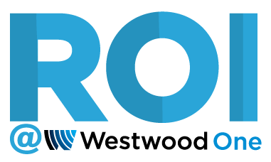
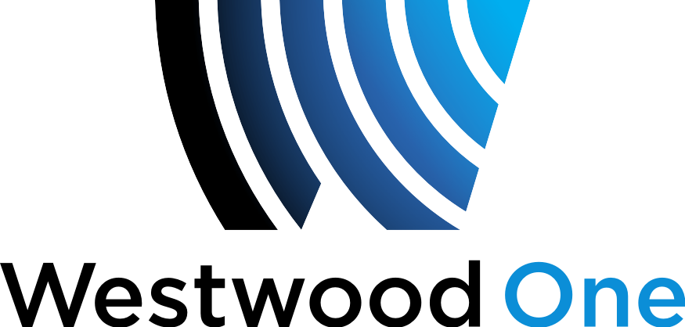
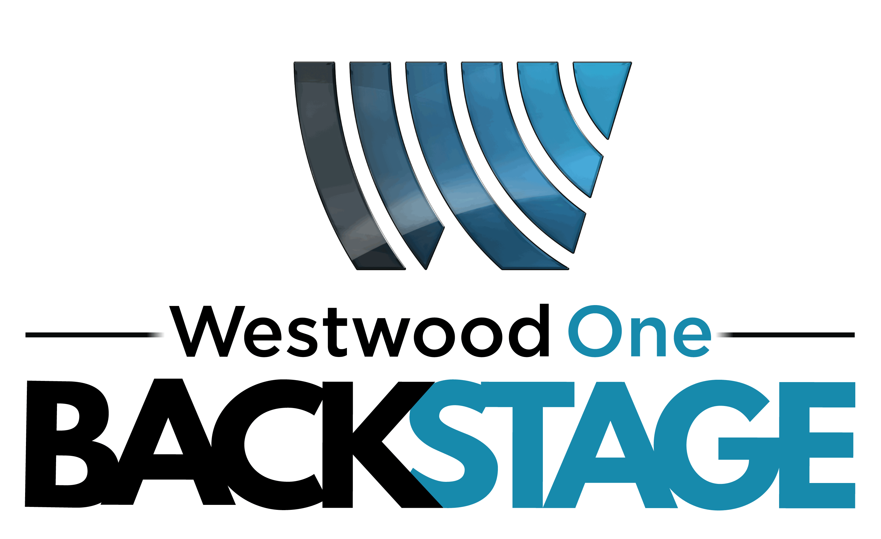
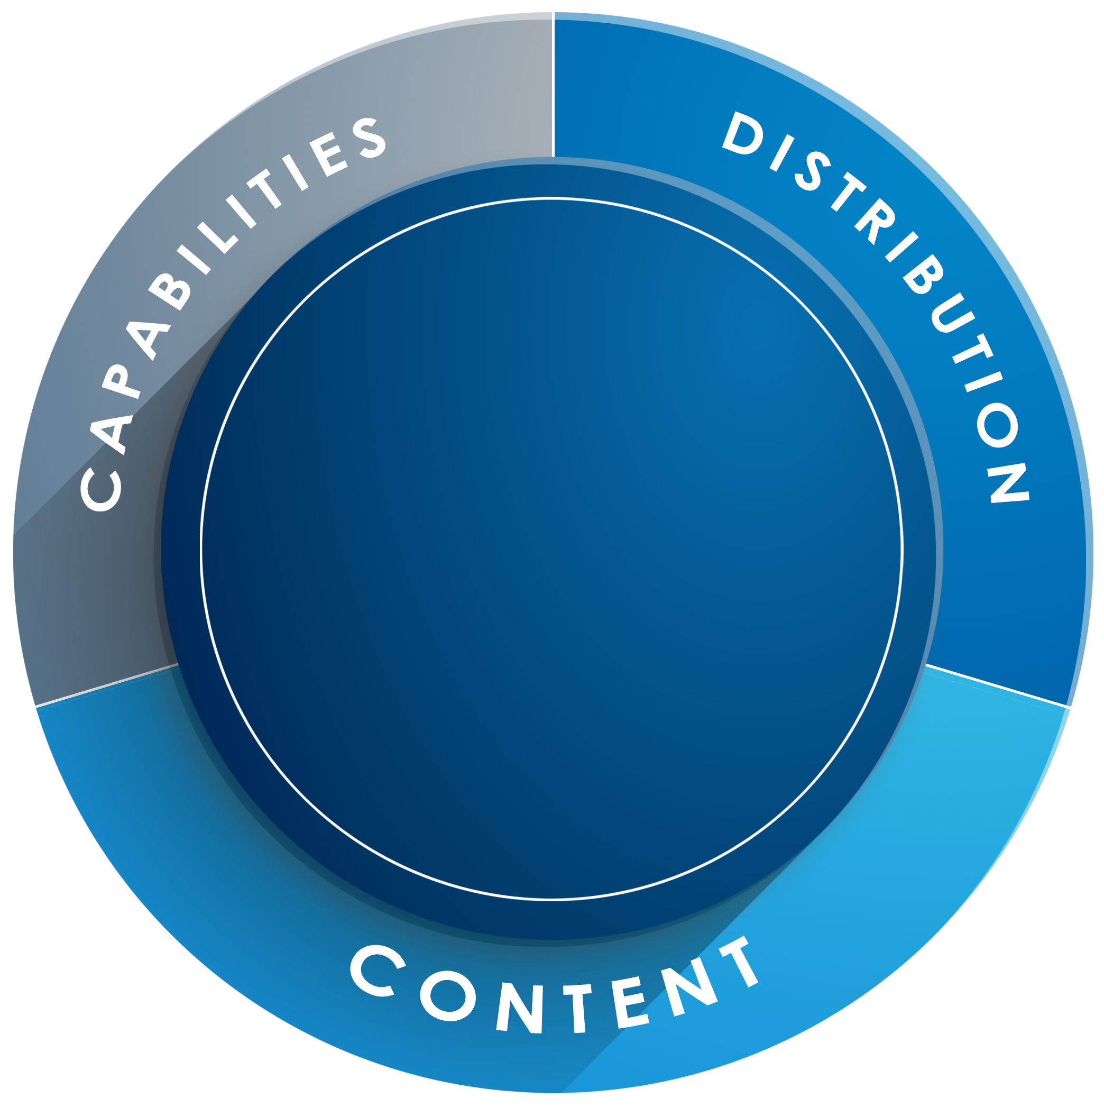




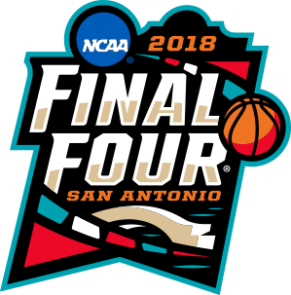
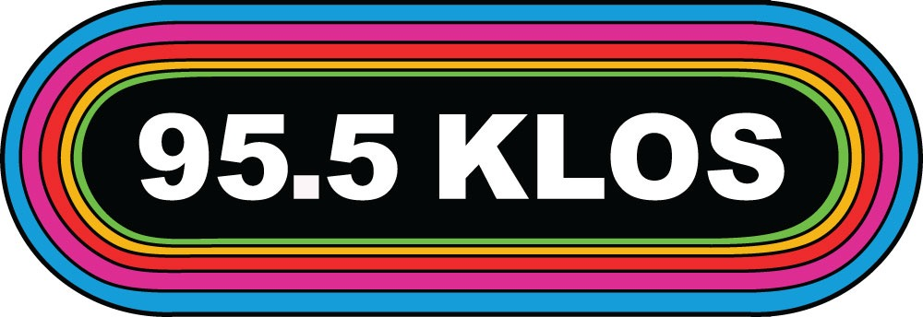


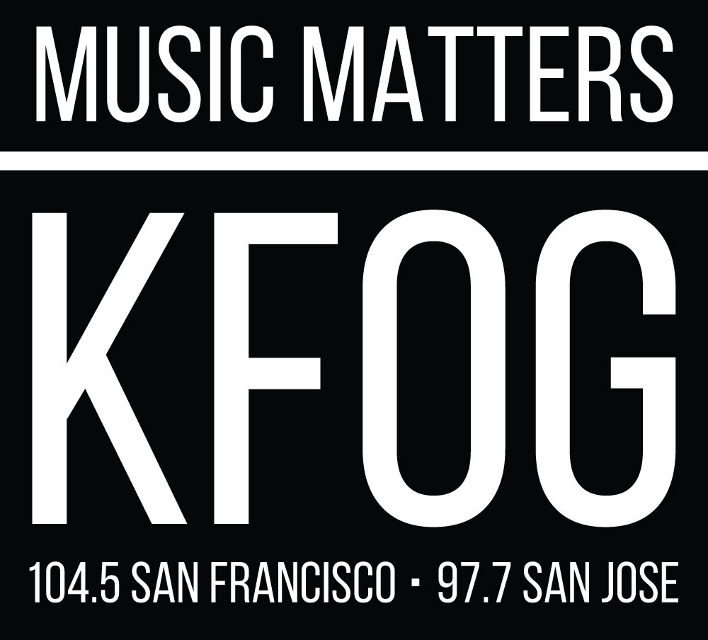




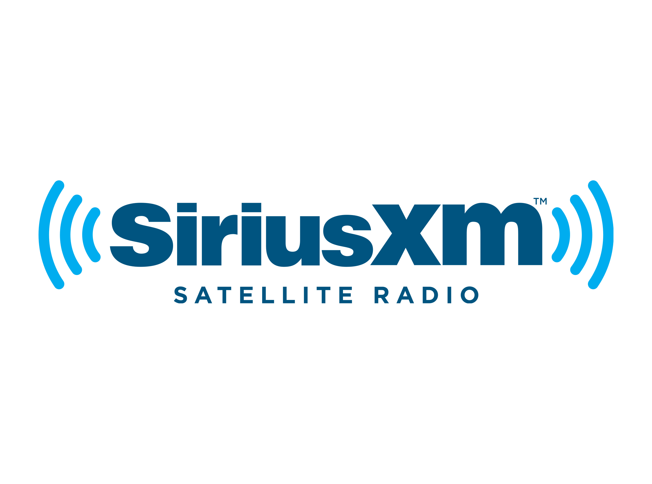
















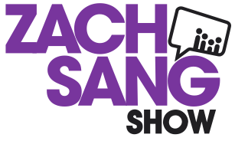








Westwood One
INSIGHTS
NATIONAL AUDIO NETWORK
8000 Affiliates
ADVERTISING +
ACTIVATIONS
LIVE + LOCAL
447 Stations
EVENTS
TALENT
DIGITAL + MOBILE + SOCIAL + PODCAST
Boomer Esiason
John Tesh
Kix Brooks
AUDIO
245 Million
Weekly Listeners
SPORTS
MUSIC + ENTERTAINMENT
NEWS + TALK
Source: Nielsen Audio Fall 2016 Nationwide, DMA, Weekly Cume of all Westwood One-affiliated stations, Mon-Sun 12m-12m, P12+
Notes:
The entire Westwood One leadership team has the enviable job of bringing our portfolio of assets and capabilities to life. We reach passionate listeners everywhere.
Westwood One can activate nationally or locally across Sports, Entertainment, Spoken Word, News, and Country. Our Experiential platform provides exclusive access to the biggest events in sports and music.
Our objective is to target the right audience and prove impact — that's why Westwood One offers best-in-class client and audience research and insights.
Overall, there are multiple touchpoints in order to reach our engaged audience.
---------
(For reference:)
National audio: reaching 245 million weekly listeners
Local activation: 447 owned & operated radio stations reaching 51 million listeners weekly
Experiential: official partner to sports and music’s biggest events
Sports: exclusive sports talk and play by play audio aligning 56 million weekly consumers and brands with premium assets
Music & entertainment: connecting 42 million weekly listeners to music and pop culture programming
Spoken word: respected talent leading passionate conversations for 22 million weekly listeners
News: 44 million listeners weekly and #1 in News – America’s 2nd most listened to format
Country lifestyle: exclusive NASH brand with premium content, onsite activations, digital magazine, and record label
Access and endorsements: talent ambassadors lending credibility to brands
Social: sharing targeted messaging with engaged consumers
Digital: streaming, satellite, podcast, and on demand opportunities with 22 million unique monthly listeners
24-hour formats: custom and turnkey full-featured radio station formats
Westwood One Studio: full-service audio creative agency
Research and insights: best-in-class insights about your consumers

Slide 4

Everyone’s Listening
245
WESTWOOD ONE REACH
US RADIO REACH
MILLION
Source: Nielsen Audio Fall 2016 Nationwide, DMA, Weekly Cume of all Westwood One-affiliated stations, Mon-Sun 12m-12m, P12+
Notes:
And where can REACH be found today? On AM/FM radio.
Nielsen reports RADIO is America’s number one mass reach media. Bigger than TV, social and mobile.
And WESTWOOD ONE is America’s largest radio network reaching over a quarter a billion people each week – which is the same number for US Radio reach.
Our more than 8,000 affiliates include large companies like CBS, Entercom, Beasley, Emmis, Alpha and Hubbard, and even iHeart, which are wonderful partners….to thousands of small town stations where the owner is out there making sales calls and serving the local community. We’re proud to be their network too.
So when you invest in Westwood One, you are tapping into the power and scale of the entire American radio industry. That’s what we mean when we say “Everyone’s Listening.” And And almost everyone is listening in their car…

Slide 5
Westwood One Audience Is Far Reaching
A Westwood One buy is a diversified buy
Cumulus represents
Affiliate stations represent
of impressions
of impressions
Composition of Westwood One Impressions
Source: Nielsen Audio Spring 2016 Nationwide, Percentages are based on Persons 12+, Based on weekly inventory for each network and broadcast group
Notes:
Three-quarters of the Westwood One audience comes from non-owned stations. This is important to brands like yours, because it ensures you’re not hitting the same people at the same stations through your local and network buys. (By way of comparison, two-thirds of the Premiere Network audience is from iHeart stations.
Westwood One counts 1200 broadcasting companies as affiliates, iHeart only has 400.)
A Westwood One buy is a diversified buy, delivering impressions at scale across the radio industry.
That’s why we say “Everyone’s Listening.”

Slide 6
Westwood and Premiere are the two largest players;
Westwood One #1 in RADAR impressions share – 4 years running
Share of Total Gross Impressions by Network, RADAR 134
Source: Nielsen Audio RADAR 134 (September 2017), Adults 25-54, Audiences to All Commercials, All Broadcasts Mon-Sun 5a-12m AQH and Weekly Inventory

Slide 7



7
THINGS
brands have completely wrong about radio

Slide 8





Cumulus Media Westwood One wanted to examine frequently heard beliefs about consumer media habits.
We turned to Nielsen, Edison Research and The Advertising Research Foundation to check the facts on these assumptions.

Slide 9
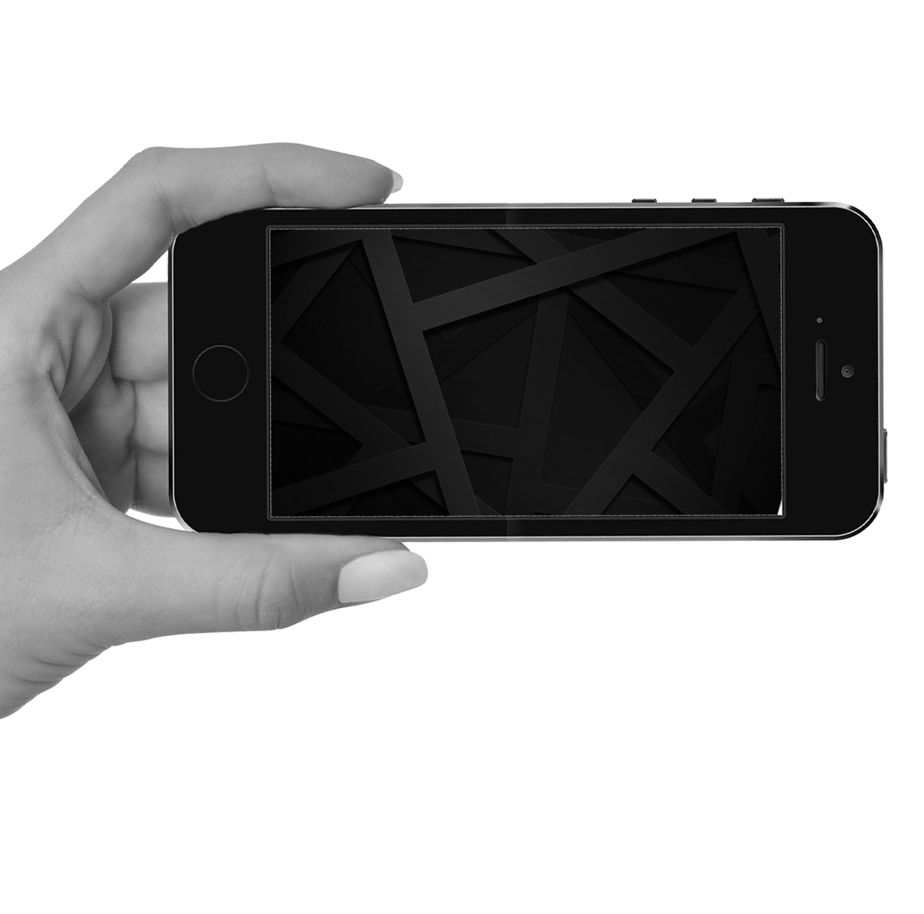

“AM/FM radio has very low reach”

Slide 10

Advertisers and agencies think AM/FM radio’s weekly reach is 62%
Advertiser Perceptions study of 316 advertisers & agencies: “What % of Americans are reached weekly by AM/FM radio?”
Source: Advertiser Perceptions, May 2017, 316 advertisers and agencies

Slide 11
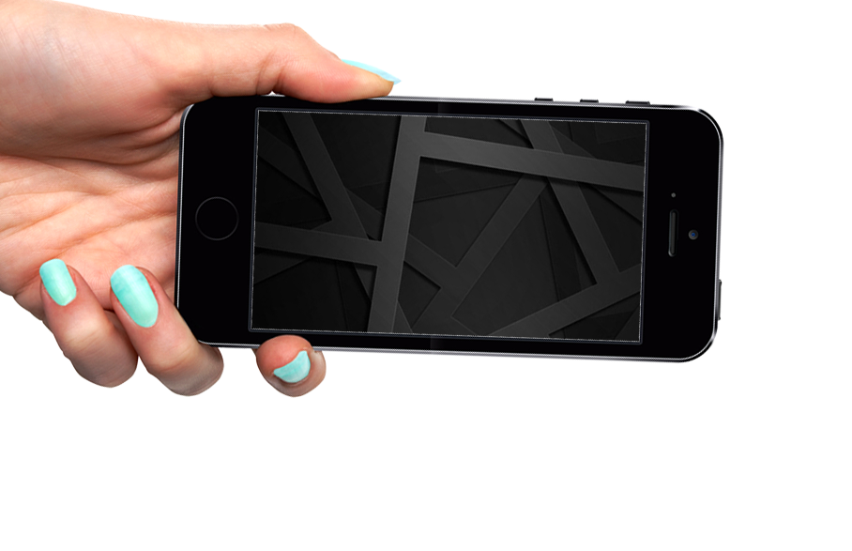

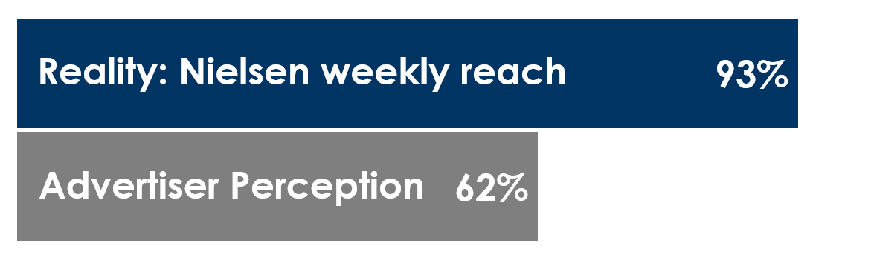
93% of Americans are reached by AM/FM radio weekly
% of persons 18+ reached weekly
Source: Perception: Advertiser Perceptions, May 2017, 316 advertisers and agencies
Reality: Nielsen Comparable Metrics Report Q3 2016

Slide 12
“If you want mass reach with Millennials,
go with television”

Slide 13
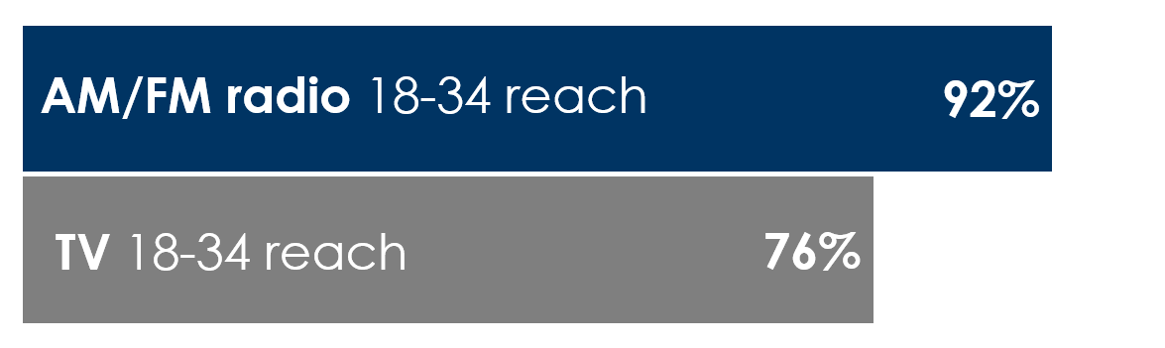
AM/FM radio is America’s #1 mass reach medium
% of persons 18-34 reached weekly
Source: Nielsen Comparable Metrics Report Q3 2016

Slide 14
“Audience shares to Pandora/Spotify are nearly equal to AM/FM”

Slide 15
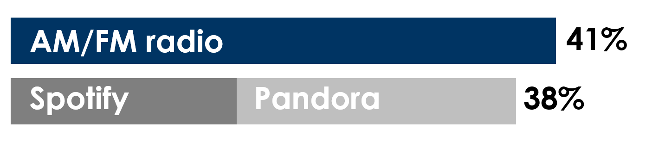
To advertisers, AM/FM radio and streaming are nearly equal
According to Advertiser Perceptions, advertisers and agencies think the share of audio time spent with AM/FM radio is nearly the same as streaming
Source: Advertiser Perceptions, May 2017, 316 advertisers and agencies

Slide 16

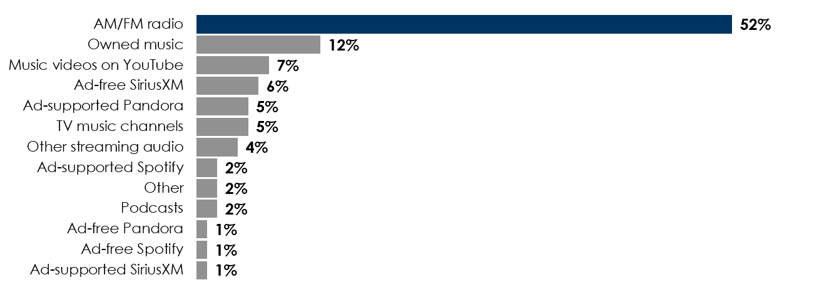
AM/FM radio is the centerpiece of audio
Share of audio time spent among persons 18+
AM/FM share of time spent listening is 8x Pandora and 18x Spotify
Source: Edison Research, “Share of Ear,” Q1-Q4 2016. Persons 18+, SiriusXM: Ad-Supported: Spoken Word. Ad-Free: Music
Percentages may not add up to 100 due to rounding

Slide 17
“In the world of the connected car, the number one thing people do is stream online radio on their smartphones”

Slide 18
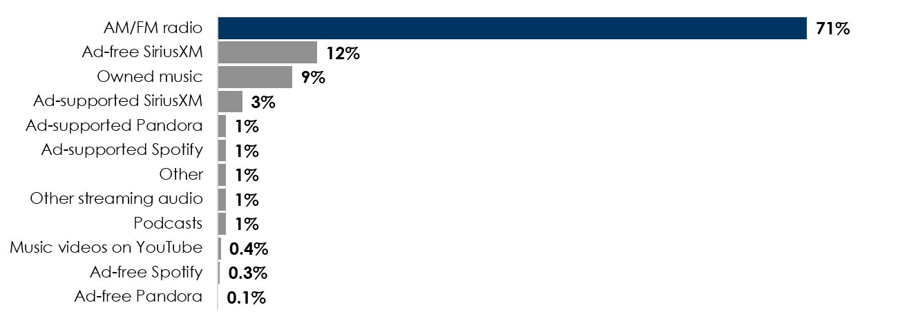
AM/FM radio dominates
in-car audio
Share of persons 18+ in-car audio time spent
Source: Edison Research, “Share of Ear,” Q1-Q4 2016. Persons 18+, in-car. SiriusXM: Ad-supported: Spoken Word. Ad-free: Music
Percentages may not add up to 100 due to rounding

Slide 19
“No one under 35 listens to AM/FM radio anymore”

Slide 20
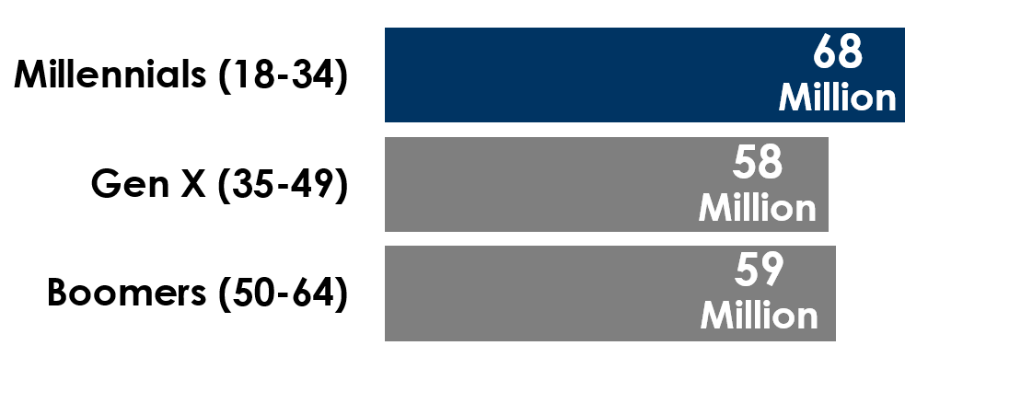
More Millennials listen to AM/FM than any other generation
# of listeners reached each week
Source: RADAR 132, March 2017, Mon-Sun 6A-12M

Slide 21
“6 out of 10 agencies/marketers believe radio listening is dropping”
Source: Advertiser Perceptions study, April 2016, study of 305 agencies and marketers.

Slide 22
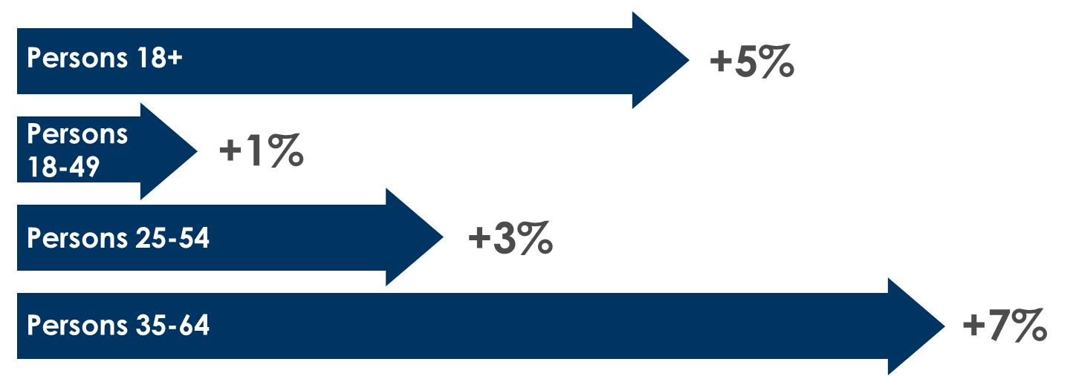
AM/FM radio is stable
Average quarter hour persons January-June 2017 vs. January-June 2015
Source: Nielsen 48 Portable People Meter Markets , Monday-Sunday 6AM-Midnight First six months of 2015 versus 2017. Average Quarter persons

Slide 23
“Would love to consider AM/FM radio; however, there’s a total lack of ROI and sales lift evidence for radio”

Slide 24
AM/FM radio has excellent ROI across multiple categories
Payback per $1 spent in radio
Sales generated per $1 spent in radio
Candy
3x
Retail
11x
Snacks
6x
Soft Drink
2x
Grocery
23x
Department
Store
17x
Fast
Food
3x
Breakfast
Bar
2x
Auto Aftermarket
21x
Telecom
14x
Mass Merchandiser
16x
Home Improvement
9x
Beer
4x
How to read: For every $1 an auto aftermarket retailer spent in radio, they saw $21 in incremental sales.
Source: Nielsen 2014-2016.

Slide 25
AM/FM Radio: setting the record straight
Myth | Fact
AM/FM radio has very low reach | At a 93% weekly reach, AM/FM radio is America’s #1 mass reach medium
If you want mass reach with Millennials, go with television | At a 92% weekly reach, AM/FM radio is America’s #1 mass reach medium among 18-34 Millennials
Audience shares to Pandora/Spotify are nearly equal to AM/FM | AM/FM audience shares are 8X larger than Pandora and 18X bigger than Spotify
In the world of the connected car, the number one thing people do is stream online radio on their smartphones | With a 71% share of in-car audio listening, AM/FM is the centerpiece of in-car audio

Slide 26
AM/FM Radio: setting the record straight
Myth | Fact
No one under 35 listens to AM/FM radio anymore | More Millennials listen to AM/FM radio weekly than any other generation
6 out of 10 agencies/marketers believe radio listening is dropping | From 2015 to 2016 AM/FM radio listening has grown +7% among persons 25-54
There’s a total lack of ROI and sales lift evidence for radio | Per Nielsen, radio generates excellent incremental sales for every dollar of AM/FM advertising across multiple categories

Slide 27

Guess who is rediscovering
AM/FM Radio …

Slide 28


Big Brands

Slide 29
“Radio Has What P&G Wants—Unmatched Reach”.
Inside Radio, September 11, 2017
« After a decades-long absence, Procter & Gamble is back in business with radio. During a NAB Radio Show panel Thursday afternoon, one of P&G’s top media and marketing execs said the company will increase its new plan to spend on radio—
“We are spending more and you’re going to see more in the next couple of quarters,” John Fix, analyst/manager—North America Media & Marketing at P&G, told a packed room of broadcasters during his first appearance at a radio event. «

Slide 30
Digital fraud and alarming TV audience erosion
caused P&G to return to radio
“P&G and other CPG giants have grown frustrated by narrow digital-ad targeting.
P&G wants to speak to everyone, not a narrow target”, Fix explained, which is
why it has rediscovered radio.
“P&G wants to reach as much of America as it can, once a week”, Fix explained.
While TV has been its media cornerstone, it’s a costly investment to use television
to reach 72% of the U.S. “The brands are looking to get the reach they want and
They can’t get it with TV,” Fix said. “Knowing that, radio seemed to be an option.”
P&G is now augmenting its media portfolio with radio buys for some of it biggest
Brands to reach Americans it can’t get through TV. “You saw 93% of household
Are listening to radio. That’s the scale I need for my brands to reach the people
that buy them,” Fix said.
Inside Radio September 11, 2017

Slide 31
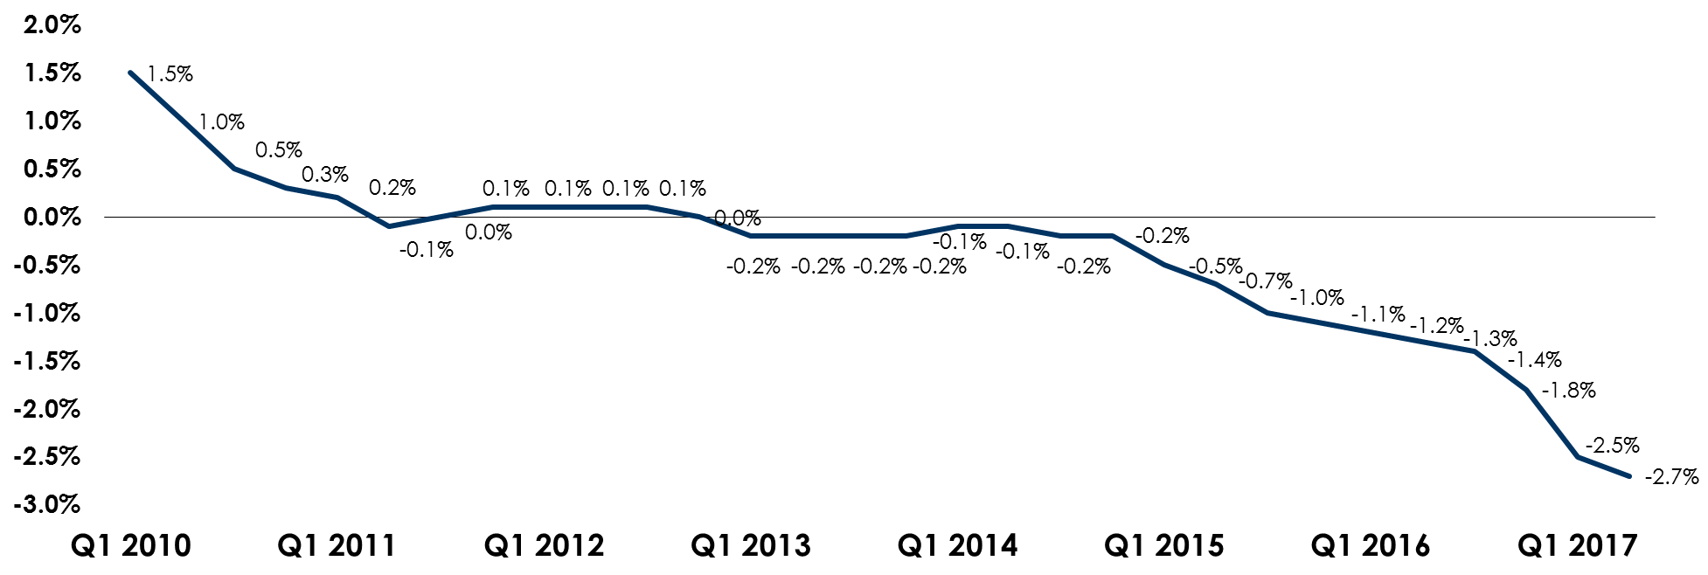
Pay TV subscriptions are falling
Pay TV subscriber growth, Q1 2010 to present
Source: Company reports, MoffettNathanson estimates and analysis, Sling TV and DirecTV Now Excluded

Slide 32

“Almost half of adults 22 to 45 years old are watching absolutely no content on traditional TV platforms, according to a new study by Omnicom Media Group agency Hearts & Science.”
“It's pretty scary,” says Hearts & Science CEO Scott Hagedorn, referring to the group as “unreachable” by marketers. “We are not reaching young audiences effectively, just over-indexing on older viewers on TV.”
“Nearly half of Millennials and Gen Xers don't watch any traditional TV”
September 22, 2017

Slide 33
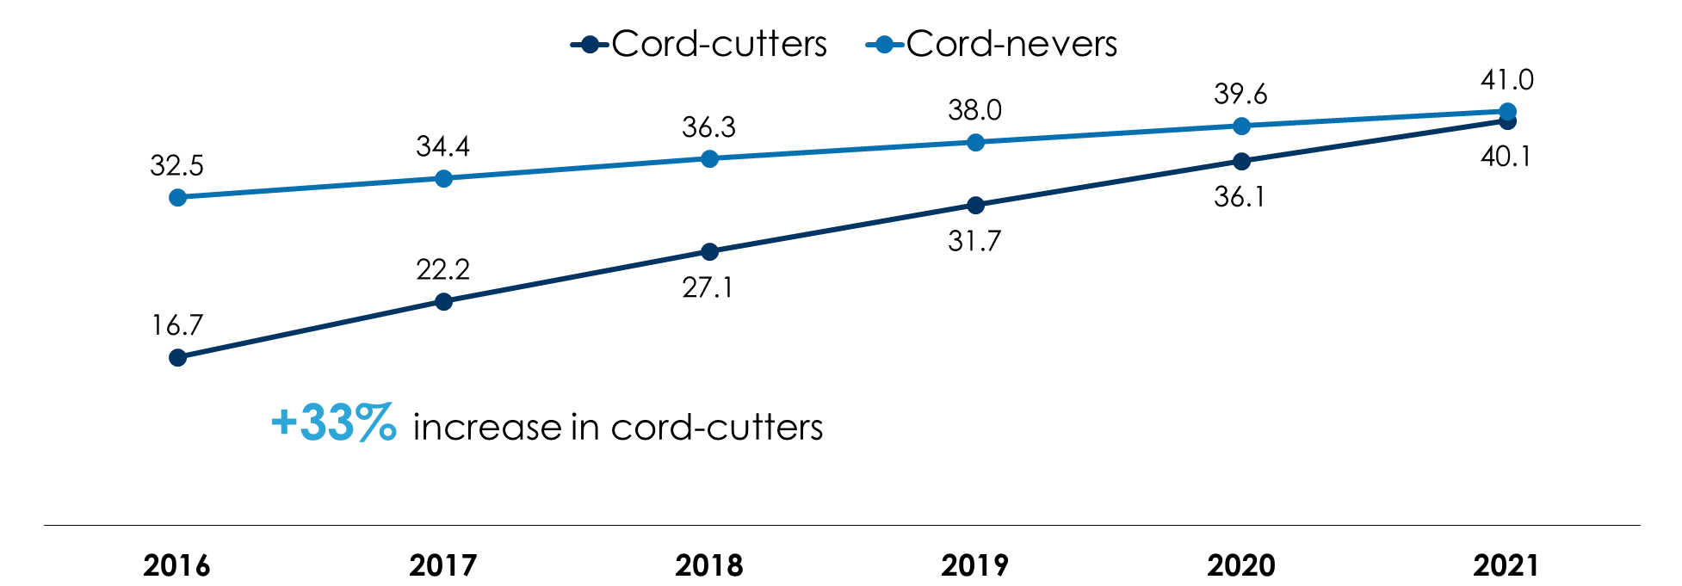
Cable ads reach fewer and fewer consumers
Non-pay TV viewers by type, adults 18+ (millions)
How to read: In 2017, 56.6 million Americans will not have pay TV and will not see cable TV ads.
Source: eMarketer, July 2017, Adults 18+. Pay TV viewers are individuals who have access to traditional pay TV services; excludes IPTV and pure-play online video services (e.g. Hulu, Netflix, YouTube, Sling TV, etc.); pay TV non-viewers are individuals who no longer have access to traditional pay TV services or have never had access to traditional pay TV services

Slide 34
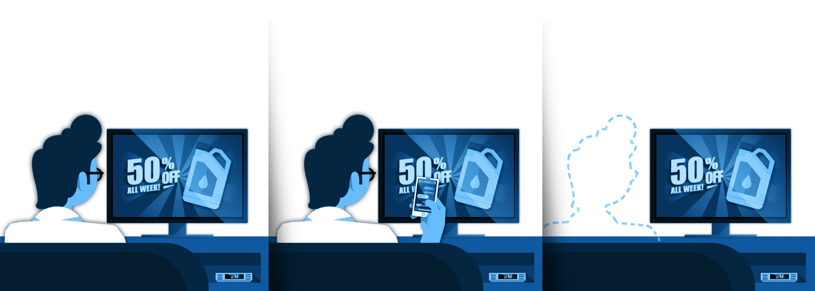
TV ads aren’t seen 61% of the time
% of time TV ads are airing
Eyes on the screen
Eyes on a second screen
Out of the room
39%
40%
21%
Source: Council for Research Excellence. Nielsen NeuroScience Study “The Mind of a Viewer” March 2017

Slide 35
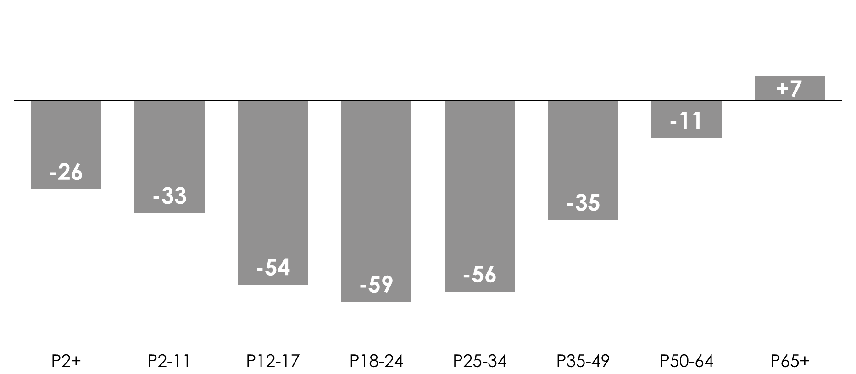
TV time spent is down
Change in hours spent watching TV per month, Q1 2017 vs. Q1 2010
Source: Nielsen Total Audience Report Q1 2010-Q1 2017, TV includes Live+VOD+DVR.

Slide 36
Heavy radio listeners are similar to heavy Internet users
Compared to heavy TV viewers, heavy radio listeners are:
younger, in larger households, more affluent, more employed, using social media
 | Heavy radio listeners | Heavy Internet users | Heavy TV viewers
Median age | 45 | 40 | 57
Annual income | $60K | $66K | $47K
Full-time employed | 51% | 52% | 30%
1 or more children in home | 41% | 42% | 26%
% using social media | 78% | 91% | 64%
How to read: This profile represents the socio-economics of the top 40% of media users based on consumption. The heaviest group of radio listeners average 45 years old with a yearly household income of $60K.
Source: Scarborough USA+ 2017 (Current 6 Months Only) Release 2 Total (Jun 2016 – Apr 2017), Adults 18+. Heavy media users defined as: 1st OR 2nd quintiles by media (top 40% of users by time spent with media)

Slide 37
Amplifying your media plan with network radio

Slide 38
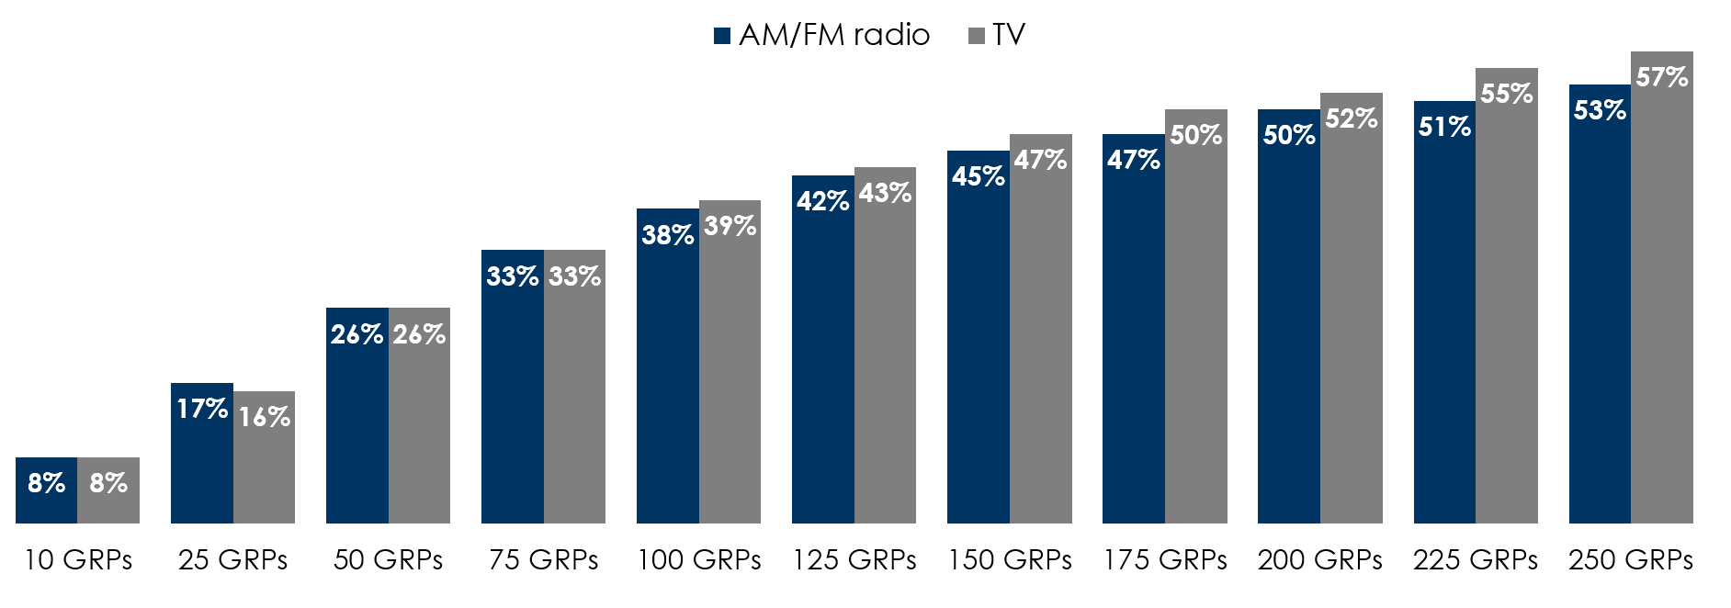
Network radio accumulates reach as quickly as TV
Adults 25-54, weekly reach accumulation by GRP level
How to read: At 125 weekly GRPs, TV reaches 43% of adults 25-54 and AM/FM radio reaches 42%.
Source: Nielsen Commspoint Research US 2016, 1 week net reach by GRP level.

Slide 39
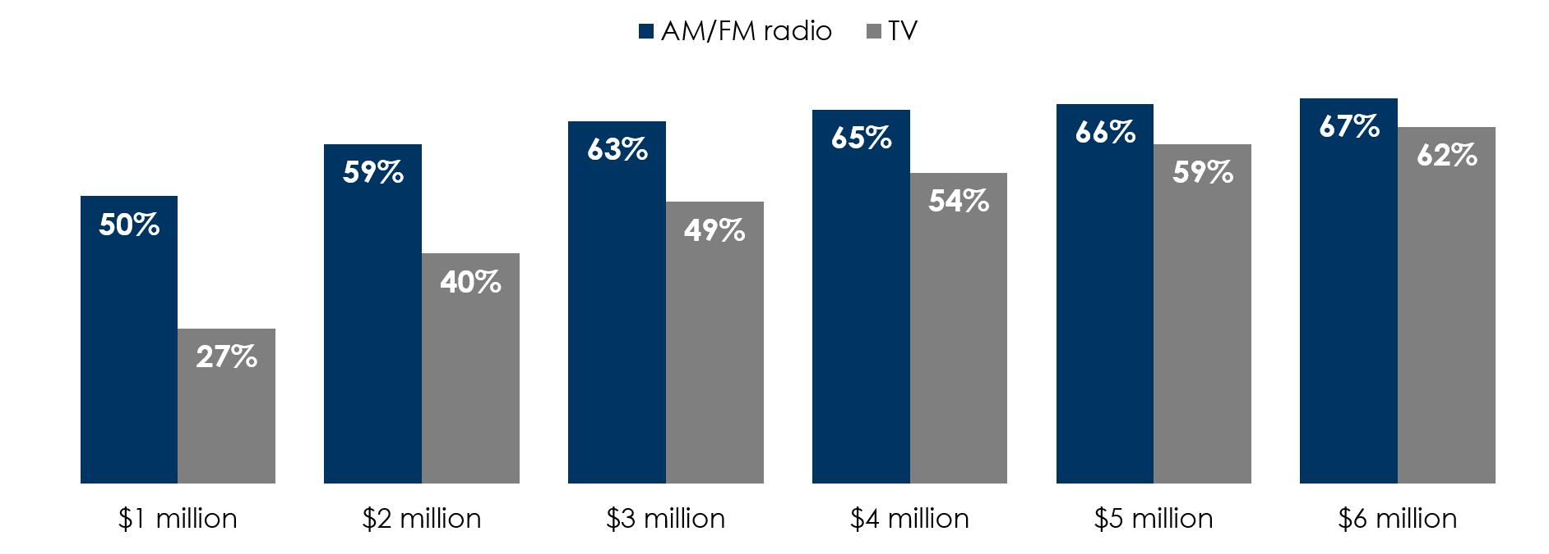
For the same spend, AM/FM radio delivers more reach than TV
Adults 25-54, weekly reach by amount spent in media
How to read: A two million dollar weekly investment achieves a 40% reach in television and a 59% reach in AM/FM radio.
Source: Nielsen Commspoint Research US 2016, 1 week net reach by GRP level. Budget determined using CPP ratios for Spot TV, Broadcast Network TV, Syndication, Cable TV, and Network Radio from Intermedia Dimensions, Media Dynamics Inc., 2015. Assuming a $5,000 CPP for Network Radio and a $20,000 CPP for Television

Slide 40
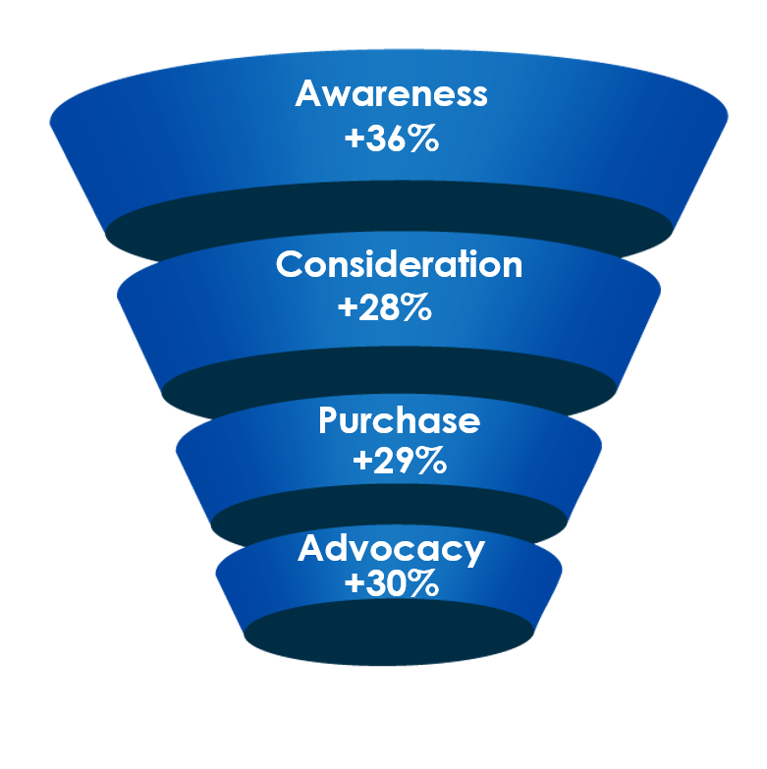
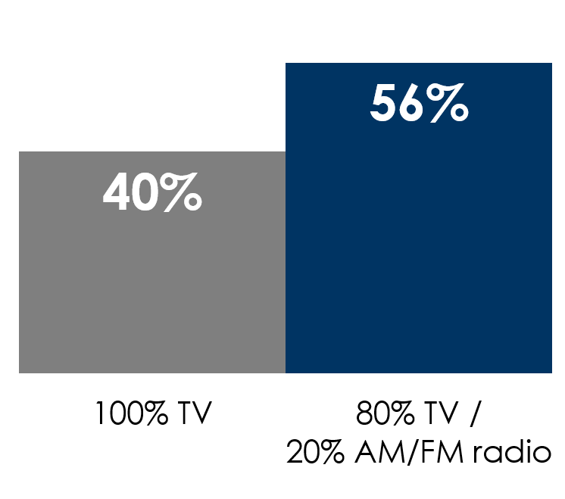
TV + AM/FM radio = more reach, greater brand impact
Adults 25-54, reach of $2 million weekly campaign
Adults 25-54, % increase allocating 20% of TV budget to radio
+40%
reach
reach
Source: Nielsen Commspoint Research US 2016, Adults 25-54, 1 week net reach by GRP level.
Budget determined using CPP ratios for Spot TV, Broadcast Network TV, Syndication, Cable TV, and Network Radio from Intermedia Dimensions, Media Dynamics Inc., 2015. Assuming a $5,000 CPP for Network Radio and a $20,000 CPP for Television

Slide 41


ONEWAY TO SMART
Notes:
Today, we are going to talk about our ONEWAY to be SMART about reaching the right customers, with the right message and proving advertising impact.
We’ll start with a SMART stat - according to a new Nielsen study of 500 ad campaigns, REACH is the number one MEDIA sales driver. Not frequency, not recency, not engagement. BUT REACH.

Slide 42
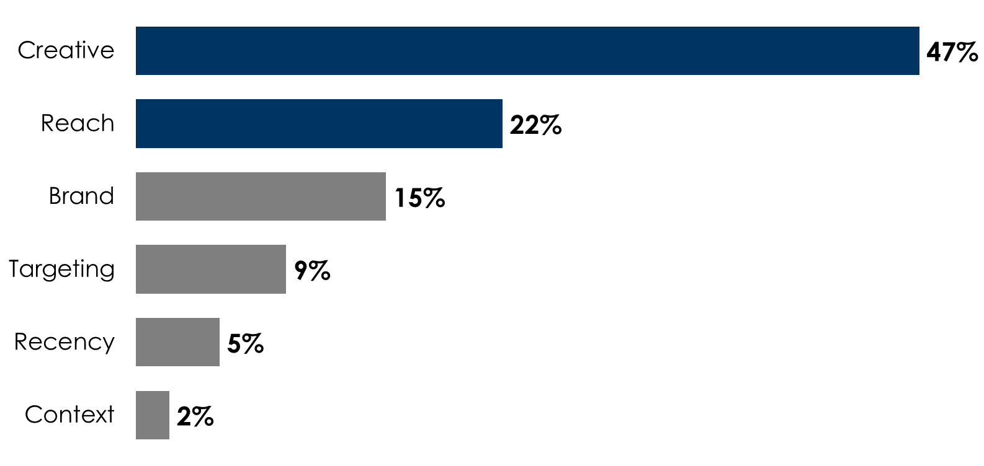
Creative and Reach Drives Sales
Nielsen study of 500 advertising campaigns and elements that contribute to sales
Source: Nielsen Catalina Solutions, nearly 500 CPG campaigns that ran in 2016 and 2017 on all major media platforms
Notes:
At the June 2017 Advertising Research Foundation conference, Nielsen unveiled a massive ROI study of nearly 500 different advertising campaigns.
The two biggest sales drivers are ad creative and reach. Nielsen’s conclusion is to grow sales, you have to reach a lot of people. Reach beats targeting as well as recency (hitting consumers just as they consider a purchase). Use Westwood OneWay solutions to master creative and then reach a huge audience with a better understanding of who your right consumer is.

Slide 43


Everyone Listens to AM/FM in the Car
Among the 146 million Americans that commute to work…
Share of audio time spent in-car among persons 18+
AM/FM Radio
70%
86%
12%
Ad-free SiriusXM
8%
In car, AM/FM radio has an
Drive in a car or truck
Owned Music
89%
3%
Ad-Supported SiriusXM
share of
ad-supported services
89%
3%
Streaming, Youtube & Podcasts
1%
Ad-Free Spotify
of car commuters drive alone for an average of 53 minutes a day
1%
Ad-supported Pandora
U.S. Census Bureau, 2014 American Community Study; Nielsen Audio Comparable Metrics Report Q3 2016; comScore August 2015, Desktop and Mobile, A18+; Edison Research, “Share of Ear,” Q3-Q4 2016, Q2 2017. Persons 18+, in-car. SiriusXM: Ad-supported: Spoken Word. Ad-free: Music. Percentages may not add up to 100 due to rounding.
Notes:
Because AM/FM is the soundtrack of the American worker.
Each day, 86% of Americans commute by car/truck with an average commute time of 53 minutes a day, accoridng to the Census.
This commute is a solo affair - 89% commute alone - AM/FM radio - and your brand - are there to keep them informed and entertained
In the car, AM/FM’s has a stunning 70% share of all audio time spent, an amazing 89 share of ad supported in-car audio time spent per Edison’s “Share of Ear”.
And Westwood One’s network audience is FAR REACHING and incredibly diverse...

Slide 44
There’s OneWay to Smart. Westwood One
OneWay provides smart data-based solutions with mass audience scale:
Reach The Right Consumer
With The Right Message
Prove Impact
Notes:
So, let’s talk about how your brand can take advantage of Westwood One’s massive reach and robust data capabilities
introducing the OneWay to Smart: Westwood One end-to-end insight and data solutions to help you identify the ONEWAY to make smart holistic media, creative, and consumer marketing decisions.
Westwood OneWay provides smart data-based solutions using a robust arsenal of full-service research solutions to:
Reach the right consumer
With the right message
And prove impact

Slide 45
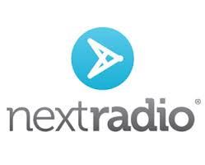





Westwood OneWay
OneWay provides smart data-based solutions with mass audience scale:
Reach The Right Consumer
With The Right Message
Prove Impact
OneWay to Smart
Notes:
Westwood OneWay provides smart data-based solutions using a robust arsenal of full-service research solutions to:
Reach the right consumer
With the right message
And prove impact
We’ve partnered with some of the recognized names in media and marketing insights.
(the difference – right now, Nielsen Marketing Cloud & NextRadio are exclusive data sources and capabilities to WWO/Cumulus. We provide better planning insights, vs. just our own footprint.

Slide 46
Nielsen data is the difference

Slide 47
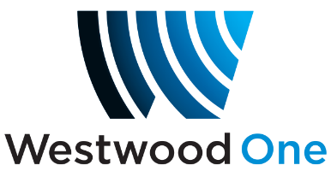
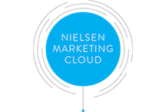
Connects actual purchase data with radio listening
For the first time, brands can target with radio based on purchase behavior rather than just age and gender
Via purchase segments, brands can plan and activate Westwood One networks, programs, radio formats and major content platforms such as the NFL, NCAA, NHL and the Olympics
Data includes credit card retail purchase, consumer packaged goods via Nielsen Catalina, JD Power auto purchase, radio and TV viewership, behavioral, interest and intent
Westwood One is the first radio organization to launch a data management platform with the Nielsen Marketing Cloud

Slide 48

The architecture of Nielsen’s Marketing Cloud
TV: National/Local
RADIO
WEBSITE
DISPLAY
MOBILE
VIDEO
SOCIAL
EMAIL
OTT-TV
CMS
TRADITIONAL
ADDRESSABLE ACTIVATION
PLAN
ACT
ANALYZE
OTHERS APPS
MEDIA IMPACT
PROFILE
DMP
DATA-AS-A-SERVICE (DAAS)
IN-FLIGHT ANALYTICS
MTA
NCS ROAS
BIG DATA INFRASTRUCTURE
DATA
1ST PARTY
TV: National / Local / RPD
RADIO
CREDIT CARD
CPG
BEHAVIORAL
LIFESTYLE
SURVEY
PARTNERSHIP
NIELSEN

Slide 49


How Westwood One utilizes the Nielsen Marketing Cloud for your brand
Targeting
Measurement
Is radio a good fit for the brand?
What radio programming formats have a rich concentration of category or brand users?
What Westwood One networks, shows, and content are a good fit?
What Westwood One digital assets are ideal for the brand?
How did the radio campaign impact sales, purchase frequency, and consumer spend?
What was the ROI of the radio investment?

Slide 50
Nielsen Marketing Cloud allows for precise consumer targeting
Heavy
Heavy category & light brand users
Heavy category & heavy brand users
Category users
Light category & light brand users
Light category & heavy brand users
Light
Light
Brand users
Heavy

Slide 51
Nielsen Marketing Cloud is Westwood One’s data differentiator
Other Audio Companies | Westwood One
Assumptive: takes digital streaming and app data and extrapolates to over the air audiences | Definitive over the air audiences: Nielsen Portable People Meter and diary data profiles actual terrestrial listening
Narrow: reports data only on their station audiences | Broad – total radio listening: across all radio audiences and formats to provide holistic planning insights about the entire radio medium

Slide 52
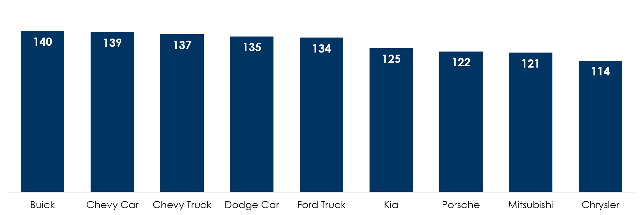
Owners of mass market auto brands are likely to be heavy radio listeners
Index of auto owners among heavy radio listeners (U.S. Avg. = 100)
WOMEN
WOMEN
MEN
MEN
How to read: When compared to the overall U.S. population, heavy radio listeners are 39% more likely to be Chevy car owners
Source: Nielsen Marketing Cloud - data reflects May 20, 2017-June 19, 2017

Slide 53
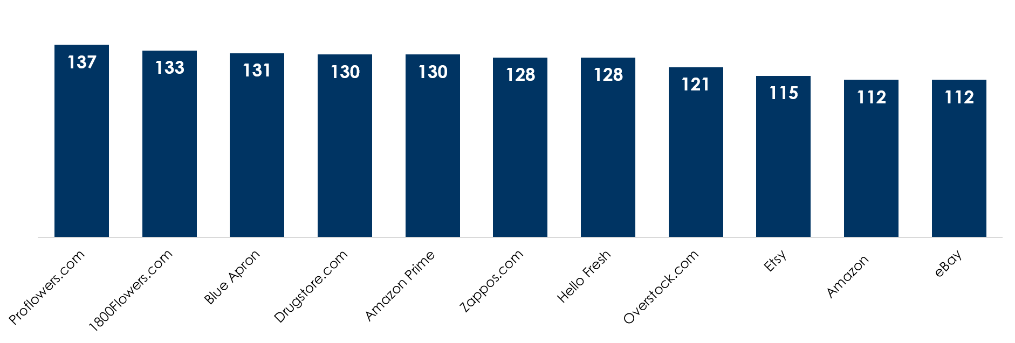
Heavy radio listeners are making purchases at major eCommerce websites
Index of heavy radio listeners by eCommerce credit/debit card purchases (U.S. Avg. = 100)
WOMEN
WOMEN
MEN
MEN
How to read: When compared to the overall U.S. population, heavy radio listeners are 37% more likely to have made a credit or debit purchase at Proflowers.com
Source: Nielsen Marketing Cloud (Nielsen Buyer Insights) – data reflects May 20, 2017-June 19, 2017

Slide 54
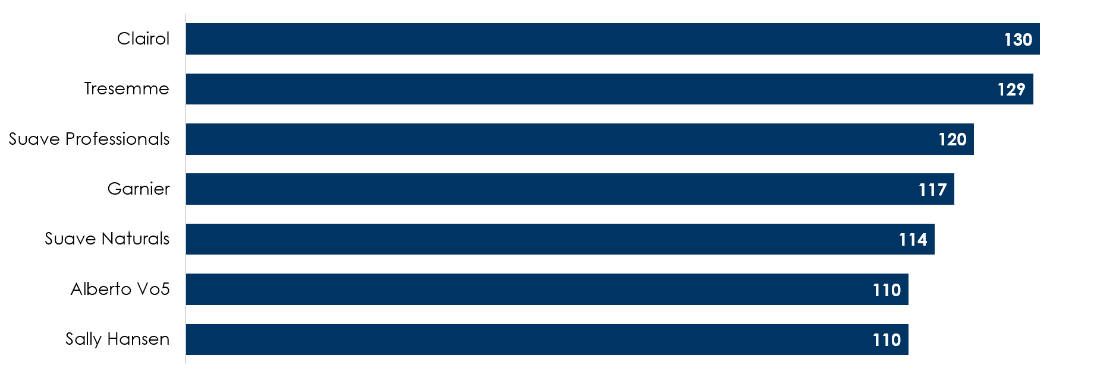
Heavy radio listeners are consumers of name brand health and beauty products
Index of heavy radio listeners by health and beauty brand purchased (U.S. Avg. = 100)
WOMEN
WOMEN
MEN
MEN
How to read: When compared to the overall U.S. population, heavy radio listeners are 30% more likely to have purchased Clairol products
Source: Nielsen Marketing Cloud (NCS Catalina) – data reflects May 20, 2017-June 19, 2017

Slide 55
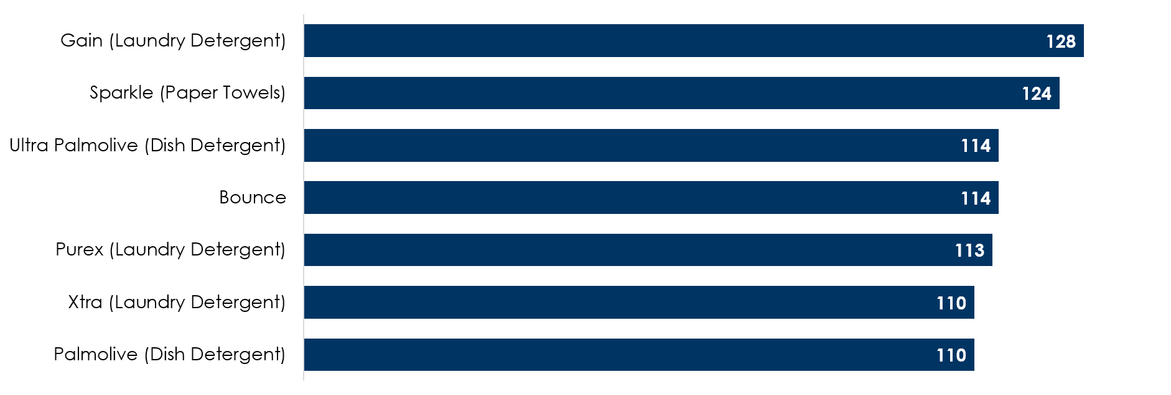
Heavy radio listeners are buying name brand household cleaning products
Index of heavy radio listeners by household supplies brand purchased (U.S. Avg. = 100)
WOMEN
WOMEN
MEN
MEN
How to read: When compared to the overall U.S. population, heavy radio listeners are 28% more likely to have purchased Gain laundry detergent
Source: Nielsen Marketing Cloud (NCS Catalina) – data reflects May 20, 2017-June 19, 2017

Slide 56




Dove Men+Care
Creative Study

Slide 57
Dove Men+Care likeability scores exceed the audio average,
10 and 15-second ads generally test worst
Q: Overall, how much do you like or dislike the ad?
% of respondents who answered “Like it a lot” or “Like it somewhat”
How to read: 69% of Men 25-49 liked Dove Men+Care’s :30 ad that’s currently running on the radio
Source: Maru/Vision Critical May 2017 National Study, Nielsen 2016 Audio Ad Studies average for Male demos

Slide 58
Memorability scores for Dove Men+Care 30-second ads exceed the audio average
Q: Thinking about the ad you just listened to, please indicate how strongly you agree or disagree with each of the statements below
“This ad was memorable”
% of respondents who answered “Strongly Agree” or “Somewhat Agree”
How to read: 72% of Men 25-49 considered Dove Men+Care’s :30 ad that’s currently running on the radio to be memorable
Source: Maru/Vision Critical May 2017 National Study, Nielsen 2016 Audio Ad Studies average for Male demos

Slide 59


AUTO PARTS MANUFACTURER
CASE STUDY

Slide 60

An American auto parts manufacturer wanted to quantify how audio could be used to build its brand and grow purchase intent.
Nielsen measured the brand impact among those who were exposed to Westwood One’s NCAA coverage versus those who did not listen but watched the NCAA on TV.
The results demonstrated the positive impact of Westwood One audio on key brand metrics, the purchase funnel, and media plan.
Methodology

Slide 61

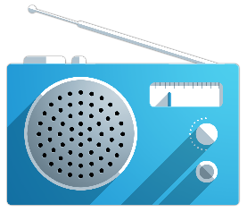
Methodology
Nielsen conducted an online survey of two groups
Analysis
Nielsen analyzed the differences between the two groups to determine radio’s impact on:
Aided awareness
Unaided awareness
Preference
Brand perceptions
Ad recall
Unexposed
Those who watched NCAA basketball on TV and did not listen to Westwood One’s NCAA basketball
audio coverage
Exposed
Those who listened to NCAA national audio basketball coverage on Westwood One
Source: Nielsen Campaign Effect: Measuring the Impact of Advertising on Brand Metrics. April 2016.

Slide 62

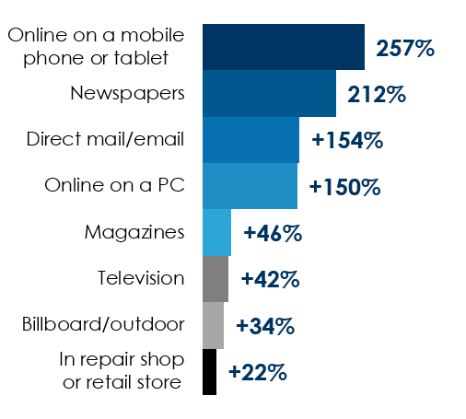

Case Study
NCAA basketball audio helps an auto parts manufacturer build its brand
Improved brand recognition
Boosted brand image
Radio elevated the media plan
+44%
+19%
brand preference
say the brand helped them understand shocks and struts
+15%
unaided awareness
Source: Nielsen Campaign Effect: Measuring the Impact of Advertising on Brand Metrics. April 2016.

Slide 63

AUTO AFTERMARKET ROI CASE STUDY
Notes:
Advertisers often ask if radio can prove ROI and sales lift. We will review a study that does just that! Today we will look at a Nielsen radio ROI case study of a major auto aftermarket brand and the effect of a radio campaign on key sales measures.

Slide 64

An auto aftermarket retailer wanted to assess the sales impact of its radio investment.
Nielsen matched the Portable People Meter panel with credit and debit card spending data from the Nielsen Buyer Insights.
Purchases from consumers exposed to the radio campaign that ran March-June 2016 were compared to consumer purchases of those who were not exposed.
Methodology
Notes:
To determine the sales impact of the radio advertising investment, Nielsen matched credit and debit card purchase data with the Portable People Meter listening panel. They analyzed spending and shopping metrics before and after the campaign. Nielsen also examined spending and shopping among consumers who were exposed to the campaign versus those who were not exposed. Let’s take a closer look at the step by step process that Nielsen used to determine sales lift and return on investment.

Slide 65
Methodology: connecting credit/debit card purchases directly with Nielsen Portable People meters
Step 1
Step 2
Step 3
Step 4
Nielsen matched Portable People Meter panel data with credit/debit purchase behavior
Audience was broken into groups based on Media Monitors ad occurrence
Nielsen measured the sales impact of the two groups
Nielsen compared spending from 2016 to the same timeframe the previous year
UNEXPOSED
to the radio campaign
PRE-PERIOD
3/3/15-6/30/15
CAMPAIGN PERIOD
3/1/16-5/31/16
MATCHED AUDIENCE
EXPOSED to the radio campaign
Unexposed
Exposed
POST-PERIOD
6/1/16-6/28/16
Notes:
First, Nielsen matches the tuning from PPM to the spending data from their credit card database. Nielsen did an address match between the Portable People Meter panel and their massive Nielsen Buyer Insights credit and debit card spending data. They ended up with 50,000 homes of “matched audience” where they have both radio listening and the credit card spending for each household. Imagine a home at 32 Elm Rock Road. From that one house, they have both radio listening and all credit card purchases.
Nielsen obtains all the ad occurrences for this radio campaign from Media Monitors, which tracks radio ad airings from thousands of radio stations across America. The exact time of each ad airs is matched to the second by second PPM tuning data. This study examined the entire radio ad campaign of the brand, not just the ads that ran on Cumulus stations or Westwood One. The audience is broken up into two groups – those exposed to the campaign who heard the brand’s ads on the radio and those who were unexposed or did not hear the ad. Nielsen examined consumer purchases at the auto aftermarket retailer for key metrics and sales measures of these groups for three time periods – the pre-period from the previous year, the campaign period which ran for three months, and the post-period which continued on for a month after the campaign ended. The post-period is important to look at to determine any delayed effects of the radio advertising.
So this entire study is based on ACTUAL BEHAVIOR. Actual exposure to the radio ads is based on matching the exact times the ads aired to the second by second PPM data. Actual spending from the credit card data is examined among those who were exposed and those not exposed to the advertising. The difference between the exposed and unexposed groups represent the impact of the radio advertising. Respondents were NOT interviewed to see if they recalled the ads or if they recalled the spending. The entire study is based on actual behavior. It is important to note that this methodology is able to isolate the impact of the radio ads on consumers’ spending even though there were many other media used by the advertiser. The impact of radio was isolated for this study. So, what did Nielsen find?

Slide 66



Key takeaways
Radio delivers strong ROI for the auto aftermarket retailer
$21:1 return on advertising spend
More buyers
Higher market share
For every $1 spent on radio, the brand saw
return on advertising spend
+48%
+71%
21
$
in total buyers
share of category spend
Source: Nielsen Buyer Insights (NBI), Sales Effectiveness Analysis, Auto Aftermarket Retailer, Persons 18+. Unexposed: 12,329; Exposed: 14,147. Pre-period = 3/1/15-6/30/15. Test period = 3/1/16-6/28/16.
Notes:
The three key takeaways are clear: thanks to radio, the brand saw $21 of incremental sales for every $1 invested, more total buyers, and higher market share of category dollars spent.

Slide 67
There’s OneWay to Smart. Westwood One
OneWay provides smart data-based solutions with mass audience scale:
Reach The Right Consumer
With The Right Message
Prove Impact
Notes:
So, let’s talk about how your brand can take advantage of Westwood One’s massive reach and robust data capabilities
introducing the OneWay to Smart: Westwood One end-to-end insight and data solutions to help you identify the ONEWAY to make smart holistic media, creative, and consumer marketing decisions.
Westwood OneWay provides smart data-based solutions using a robust arsenal of full-service research solutions to:
Reach the right consumer
With the right message
And prove impact

Slide 68

Let’s Work Together.
Notes:
****This is the end of the presentation, this is the launch slide to engage the client in conversation and start the process of working together.

Slide 69

THANK YOU
Notes:
We can help your brand be pitch perfect when it meets its most important consumers, identified by using the most robust data solution sets in broadcast radio. Thank you so much.

